Slide 1


INSTRUCTOR : DR. PRADEEP BUDDHARAJU | MENTOR : MR. RAJ GUPTA
FANTASY CRICKET-MOBILE APPLICATION
FANTASY CRICKET-MOBILE APPLICATION
Prashant Kora | Rakesh Gattu | Sreeharsha Parankusham | Vishwas Gouru
iOS

Slide 2
CONTENTS
Problem statement
Introduction
Requirements gathering
Design
Implementation
Demo
Project management
Conclusion and Future Work
References

Slide 3
PROBLEM STATEMENT
“How to play fantasy cricket when we are on the go?“

Slide 4
INTRODUCTION
Fantasy cricket is an online game where you create a virtual team of real cricket players
Users cannot always open their desktops/laptops when they are on the go
This mobile application is designed to let the users play when they are on the go
Applications like Play fantasy cricket, Fantasy IPL cricket also have similar functionalities

Slide 5
REQUIREMENTS GATHERING
User requirements | Functional requirements | System requirements

Slide 6
User requirements | Functional requirements | System requirements
A login view is provided to all the players to access their accounts
If they don’t have one, they have to create one
Players can choose their playing teams including fantasy players
Based on the performance of the fantasy players in the matches players will get the points
A leaderboard will be maintained to display
It should support IPhone/ IPad/ IPod

Slide 7
User requirements | Functional requirements | System requirements
A view with a sign-in and register options will be shown
A view to register for an account
An initial amount is given to players to buy fantasy players
A list of fantasy players are kept in a pool
Static amount is dedicated to each and fantasy player
Player’s leaderboard is updated as soon as the admin starts the league
Sum of all the points of fantasy players are added to player’s table
The leaderboard displays all the players ranks in ascending order

Slide 8
User requirements | Functional requirements | System requirements
An IPhone/ IPad/ IPod with an IOS later version 7.0
100MB of free space
Internet connection is necessary
SQL server 2012
Xcode

Slide 9
USER INTERFACE DESIGN
Login view
Leader board view
Select format view
Pool view
Selected team view
Registration view
Player’s team and points view

Slide 10
FLOW OF APPLICATION
Login
Leader board
Register
Settings
Player’s team
Pool
My Team

Slide 11
IMPLEMENTATION
We chose “Swift” as the programming language on Xcode platform
Programming is done by using MVC design pattern
Web services has been implemented to write and read tables from database
The data is retrieved in JSON format
Version control is used to commit a view when its functionality is done
Leader board | Pool | History | Settings

Slide 12
LEADER BOARD
Leader board deals with points of all players participating in the league
Names of the players are arranged in ascending order
A table view is used to display the players names
Each cell is given to every player
A click on the cell navigates to a new view
This view displays his team members names and points scored in that league
Leader board | Pool | History | Settings

Slide 13
POOL
One-third part deals with total amount given and the amount left
Remaining two-third part of the view displays all the fantasy players names and their prices
Each cell is dedicated to every fantasy player
A click on the cell selects that particular fantasy player
After selecting the players, if you click on save button, it navigates to another view which shows your selected team
Leader board | Pool | History | Settings

Slide 14
HISTORY
This view displays the points of the particular player
Even here, we have used table view to show the points
Each cell shows team names, match date and time
Leader board | Pool | History | Settings

Slide 15
SETTINGS
In this view, we ask the player to select the format of selection for the league
It will ask for the name of the team.
Prior to the team selection, the player has to select the format
Formats to select from are:
5 batsmen, 1 wicket-keeper, 3 all-rounders and 2 bowlers
4 batsmen, 1 wicket-keeper, 4 all-rounders and 2 bowlers
4 batsmen , 1 wicket-keeper, 2 all-rounders and 4 bowlers
4 batsmen, 1 wicker-keeper, 1 all-rounder and 5 bowlers
Leader board | Pool | History | Settings

Slide 16
CHALLENGES FACED
While extracting the data from the database in JSON format
httpget (request)
NSJSONSerialization to retrieve in JSON format
To post the data to the database
We used different web methods to post the data to database
To develop player selection view
Created a list array before loading

Slide 17
CHALLENGES FACED(CONT..)
While integrating views
Created a separate list array
While loading a view with different data in multiple situations
Defined two different web methods

Slide 18
TESTING
Unit testing is done on every functionality
Integration testing is done while performing integration of views
While performing these views, we have experienced some bugs in the functionality
Posting data in to two different tables
Once the team is created, editing that team didn’t give expected result

Slide 19
CONCEPTS LEARNT
How to deal with iOS user interface
How to use web services for mobile applications
How to use the database which is developed for web application in mobile application
How to retrieve data from the database
How to replace the data after editing a view

Slide 20
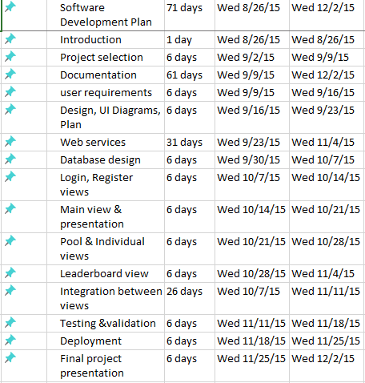
PROJECT MANAGEMENT

Slide 21
RESPONSIBILITES
Prashanth Kora
Gather Requirements.
Sreeharsha Parankusham
Rakesh Gattu
Design and Develop
Design and Develop
Communicate with mentor and instructor.
Database administration.
Application Web Services.
Design and Develop Views
Design and Develop
Vishwas Gouru
To test and validate the code.
History view.
Data Transfer Web Services.
Version control.
Leaderboard. View.
Settings view.
Log-in.
Registration.
Player pool View.
Team view.
Points view.
Update and maintain the website.

Slide 22
CONCLUSION AND FUTURE WORK
Fantasy cricket might not allow you to play in the league but it will give you a feel that your selected team is playing it
Your perception regarding team selection among other players can be ranked accordingly
We can notify the players about the league before it starts
We can ask for a passcode without asking for login/password if the application is opened on the same device repeatedly
We can also add a functionality like automatic selection of the team

Slide 23
REFERENCES
“The swift programming language”. (2015, Oct 15th). [online]. Available : https://developer.apple.com/swift/
“udemy website”. (2015, Oct 15th). [online]. Available : https://www.udemy.com/apple-mobile-app-development-with-swift-xcode-and-ios/
“Stanford - developing IOS8”. (2015, Feb 8th). [online]. Available : https://www.youtube.com/watch?v=GOEPVM5OzJk&list=PLy7oRd3ashWodnpf8rjfYEkTgwbOEsKfU

Slide 24
DEMO

